Slide 1
FDTD 전수 Check List
Workstation-NBTP IP: 141.223.166.50 (라이선스 서버)
Workstation-NBTP2 IP: 141.223.166.51
NBTP_FDTD IP: 141.223.166.163 (실습용)
FDTD Basics
Finite Difference Concept
Yee Cell
Courant (Stability) Condition
2. FDTD Solutions 사용법
Basic Options
Material Parameters
Data Import & Export
Curve Fitting, Weighting
Meshing → Convergence Test
Mesh Override Region
Mesh Oder
Courant (Stability) Condition
Auto Shutoff
Boundary Condition
Periodic
Bloch
Perfectly Matched Layer (PML) → Convergence Test
Symmetry, Anti-Symmetry
Source
Source Setting
Plane Wave
Gaussian Source
Monitors
Power Transmittance
Field Intensity
Poynting Vector
Far-Field Injection
Power Absorption (Power Conservation Law)
Movie Monitor
Script
각종 명령어 숙지
구조 그리기 자동화
Data 추출 자동화
Data 처리 (Image & Plot)
Efficiency & Crosstalk 계산방법
Image Plot Format 숙지
MATLAB을 이용한 자동화 Code 작성

Slide 2
Finite-Difference Time-Domain

Slide 3
Finite Difference Concept

Slide 4
Finite Difference Concept

Slide 5
One-Dimensional Free Space Formulation
• Maxwell’s curl equations in free space
• A simple one-dimensional case using only and
→ 시간, 공간 미분 모두에 대해 Central difference approximation을 적용

Slide 6
One-Dimensional Free Space Formulation
• Maxwell’s equations using central difference approximation

Slide 7
One-Dimensional Free Space Formulation
• Maxwell’s equations using central difference approximation

Slide 8
Courant (Stability) Condition
• Courant Condition

Slide 9
Maxwell’s Equations in Cartesian Coordinates

Slide 10
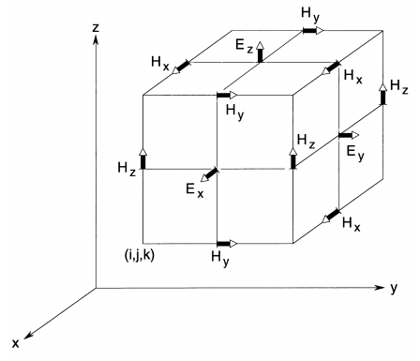
The Yee Cell

Slide 11
Finite Difference of Maxwell’s Equations in 3D
- General Case
- Free Space

Slide 12
Ampere’s Law

Slide 13
One-Dimensional Free Space Formulation
• Normalization

Slide 14
Courant (Stability) Condition
• Courant Condition

Slide 15
EM Theory for Data Analysis

Slide 16
Time-Average Poynting Vector
• Using phasor method and Euler’s formula
• Time-average Poynting vector
: Time-average Poynting vector [W/m²]
: FDTD Solutions Power Monitor 출력 물리량 (참고)

Slide 17
Power Absorption from Power Conservation Law
• Maxwell’s Equation
• Using scalar multiplication
• Using the vector identity
: Absorption power per unit volume

Slide 18
Power Absorption Calculation in FDTD Solutions
→ 실제 계산에 적용

Slide 19
Poynting Vector vs. E-Field Intensity
EM Waves
Poynting Vector
E-Field Intensity
Sum of Each Plane
Wave Intensity
Interference
Net Power Flow
Non-propagating Resonance
(Interference)
기존
Poynting Vector Real Part 만 고려
향후
Interference 현상의 이해를 위해
Poynting Vector Imaginary Part 도 함께 고려

Slide 20
Electromagnetic Waves in Dielectric Slab (1D)
EM Waves
Poynting Vectors

Slide 21
Poynting Vector & E-Field Intensity for Dielectric Slab
Real Part of Poynting Vector
Electric Field Intensity
Imaginary Part of Poynting Vector

Slide 22
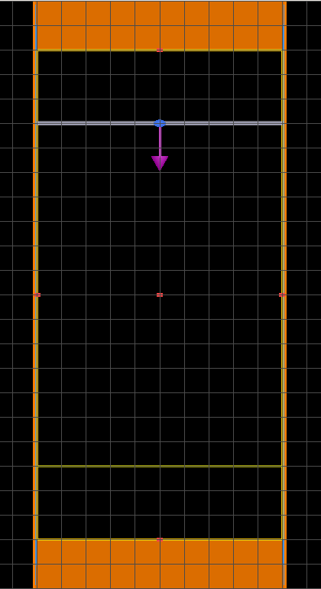
Practice list
1. Convergence TEST
Using the server computer alone, execute the convergence test for the given structure
Display the results by MATLAB plots
Perfectly Matched Layers (PML)
Plane wave source
wavelength : 0.4um ~ 0.7um
Periodic boundary
Monitor (Frequency & Power monitor)
PML Convergence test (with fixed mesh per wavelength)
simulate the structure in the case of the number of PML layer = 10 ~ 100
Mesh Convergence test (with fixed PML Layer)
simulate the structure in the case of the number of mesh/wavelength= 5 ~ 60

Slide 23
Practice list
2. Script usage
1 μm
Plane wave source
wavelength : 0.4um ~ 0.7um
Thickness = 100 nm ~ 300 nm by interval 50 nm
(n = 2)
Monitor (Frequency & Power monitor)
Using Script, Automatically draw the structure and compare the transmittance.
+) Study about parameter sweep in Lumerical FDTD solution
+) Establish the MATLAB code for transfer matrix, compare the results

